Slide 1


Students Performance Prediction in Exams
Rama Danda
DSC 680 - Summer 2021

Slide 2
Domain Background
Domain- Student education data, part of Educational Data Mining
EDM- Refers to the techniques, tools, and research designs utilized to obtain information from primary educational records, from institutions student admission, student records, student financials and other survey data associated to students.
Use case reason- Educational data analysis deals with processes & methods to discover hidden patterns from student education to formulate conclusions both for descriptive and inferential statistics

Slide 3
Domain use case
This study involved in analyzing and predicting student performance rate for educational institutions.
Who benefits-
Students:-
Students could be informed about the potential pitfall early in the courses who could fall behind
Take remedial actions before it’s too late
Institutions:-
Keep over all standards high
Intervene early by student counselors
Monitory benefits against losing a student mid way

Slide 4
Data sources
University of Jordan student system in association with Ibrahim Aljarah-
Secondary data sources is through University of Southern California Student Performance Data Set
Data source links:
1) http://www.ibrahimaljarah.com/
2)https://archive.ics.uci.edu/ml/datasets/student+performance

Slide 5
Defining the features & Target Variable
Students who are having difficulties completing the programs show signs in their grads, and are influenced by many factors like
Gender, Nationality, Educational Stages, Grade Levels, course topic, school year semester, Parent responsible for student, raised hand, visited resources, viewing announcements, Discussion groups Parent Answering Survey, Parent School Satisfaction, Student Absence Days etc.
Target label
Grade a student would get which are classified in to
Low-Level: interval includes values from 0 to 69.
Middle-Level: interval includes values from 70 to 89.
High-Level: interval includes values from 90-100.

Slide 6
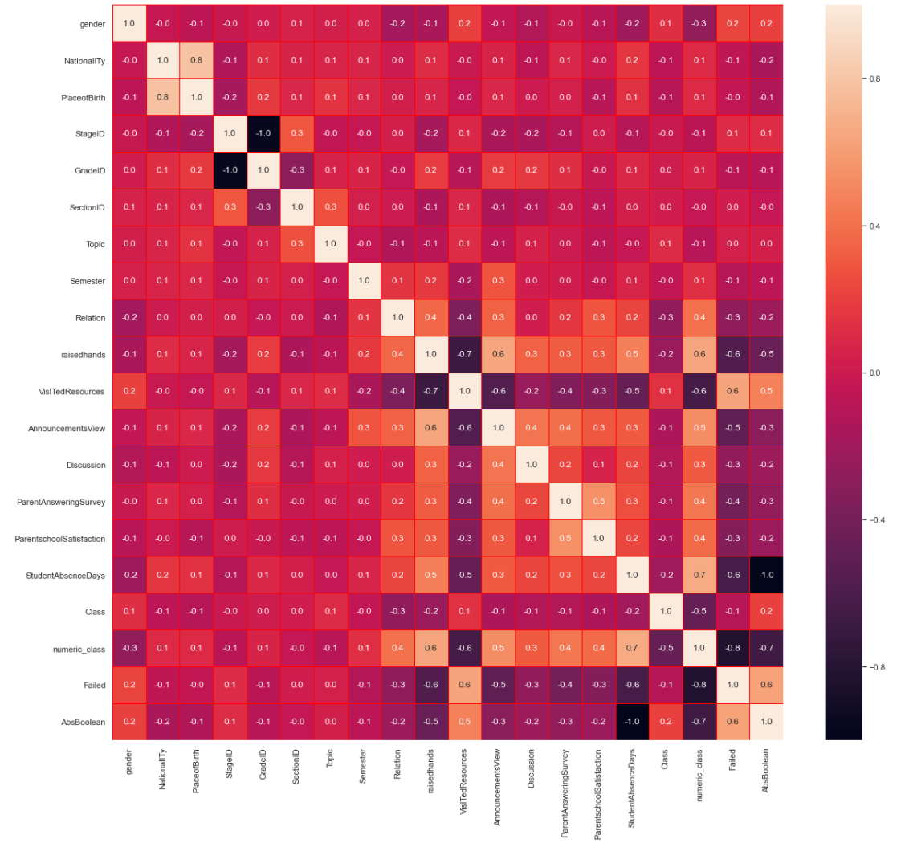
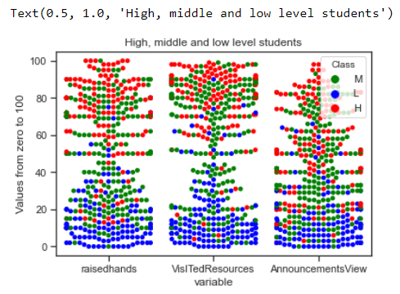
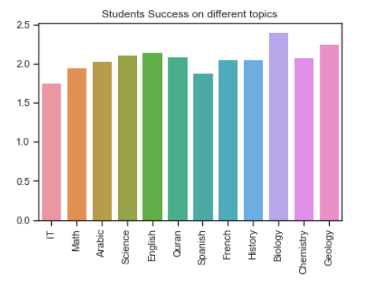
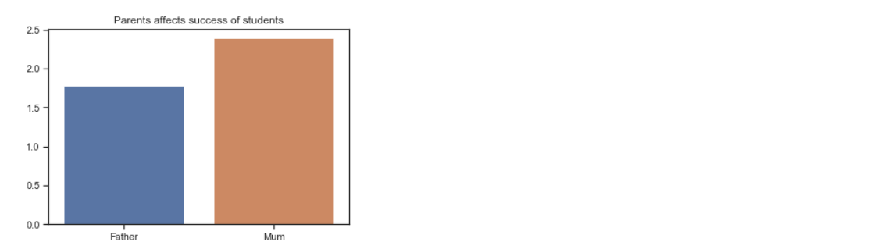
EDA
Swarm plot shows how students have higher values of raising hands, visiting resources, and viewing announcements take high level values.
correlation plot of different input which indicate strong correlation between place of birth, raised hand and announcements checking, absence days to parent’s school satisfaction.

Slide 7
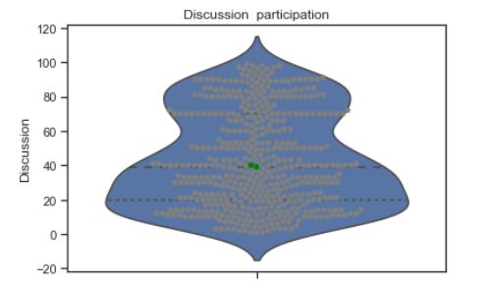
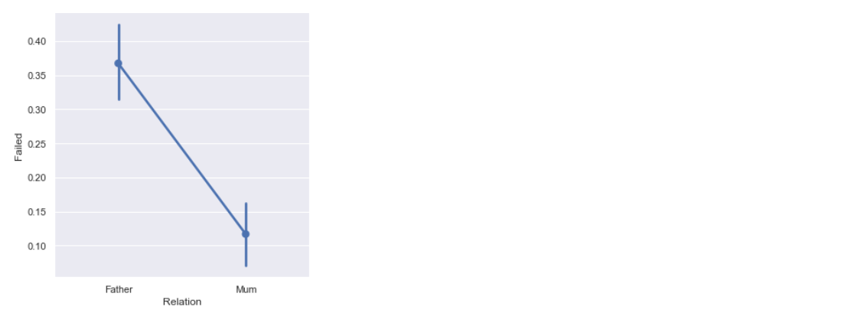
EDA
Family members and their effect, that show some sign of mother influence on success rates while discussion rates of participation have effect on students.
Students whose parents are generally satisfied with the education they received higher grades, while parents were least satisfied with the school performed much in lower levels.
It also says the influence of mothers on student’s failure rates, that is mothers influence has lower failure rates. Also, lowest performers did not visit the course resources as much as high performers.

Slide 8
Data Preparation, transformations & Imputation:
Our data did not have any missing values. Input dataset already had numerical values, so less effort was done to prepare the Data.
Some of the variables like ‘TotalQ’ derived from input dataset variables class with low, mid, and high level and used melt to widen the data frame.

Slide 9
Modeling & Results
70% of data points are used for training, the remaining 30% is used for validation of the training data
SVM classifier results produced an accuracy of 67% with ‘rbf’ kernel, while replacing y values with derived ‘TotalQ’ values of Low, Mid and High values, the accuracy went up to 74%.
Random Forest Classifier, when n_estimators=200 for the best accuracy result and so redo the estimator 100 and 200, which went by accuracy to 0.74

Slide 10
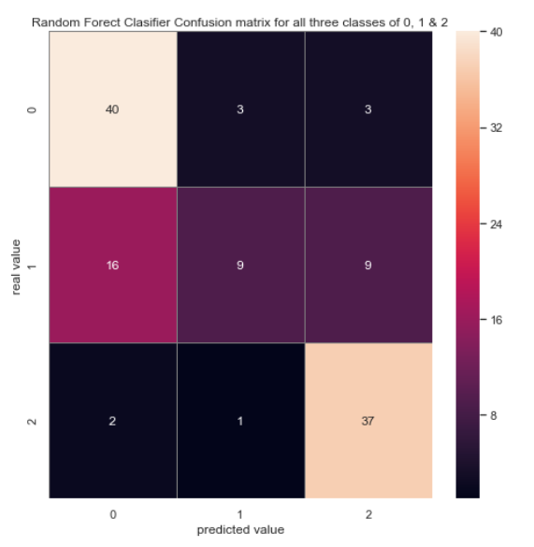
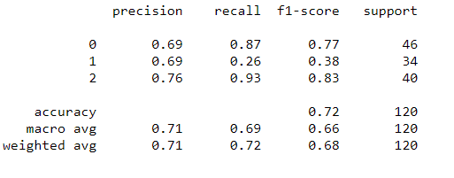
Results
Overall performance of the model was determined by average Precision and Average Recall values for each model.
Random Forest Classifier is the best performing classifier at 74% and would be a best fit for the given data along with the confusion matrix Precision and Recall values for FC model for high performer.
Algorithm Name | Accuracy
SVM: | 67%
MLPClassifier | 67%
Liner Model | 62%
GridSearchCV | 70%
RandomForestClassifier | 74%
GaussianNB | 65%
DecisionTreeClassifier | 65%

Slide 11
Conclusion
Conclusion/Discussion:
Factors effecting student performance from EDA is evident with nationality (Jordan nationals) performed better, working on Chemistry, and having relation with mother has positive effect on the levels. While being male, participate(less) in discussion and absence more than 7days has negative effect on the scores.
Based on above accuracy metrics Random Forest Classification at 74% is more suited for the data set in predicting students’ performance

Slide 12
Reference
1) Student Performance Data Set
https://archive.ics.uci.edu/ml/datasets/student+performance
2) Students' Academic Performance Dataset xAPI-Educational Mining Dataset
https://www.kaggle.com/aljarah/xAPI-Edu-Data
3) Why is Educational Data Mining important in the research?
https://towardsdatascience.com/why-is-educational-data-mining-important-in-the-research-e78ed1a17908

